Slide 1
LESSON 8: NUMBER-THEORETIC FUNCTIONS
CSC 30400: Introduction to Theoretical Computer Science
Instructor: Professor Stephen Lucci

Slide 2
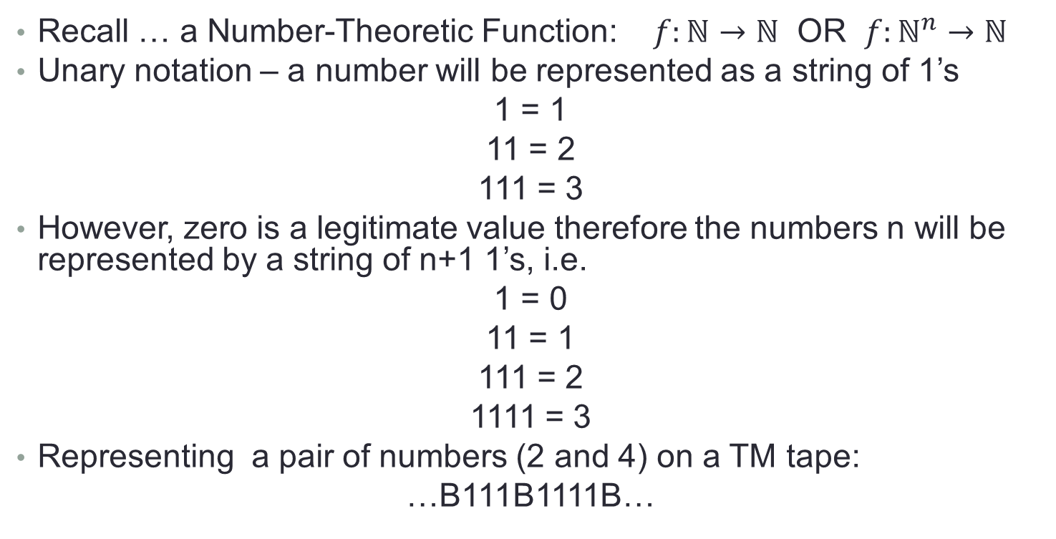
TM’s to compute Number-Theoretic Functions
the additional 1 will be referred to as a representational 1. (first or last 1 … does not matter)

Slide 3
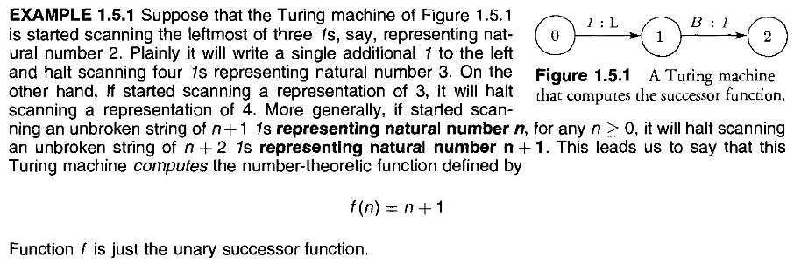
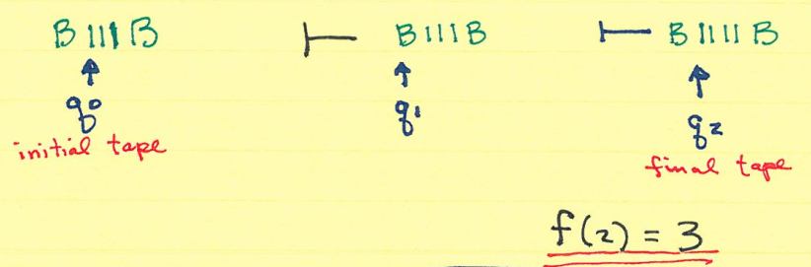
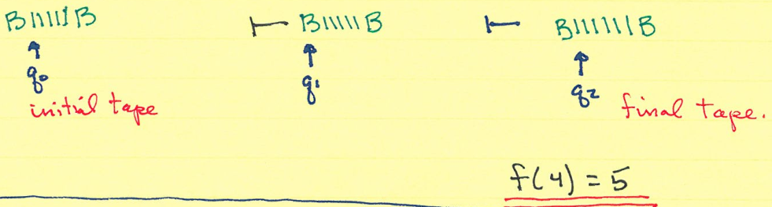
Example 1.5.1

Slide 4
How should TM, M behave when f is a partial function?

Slide 5

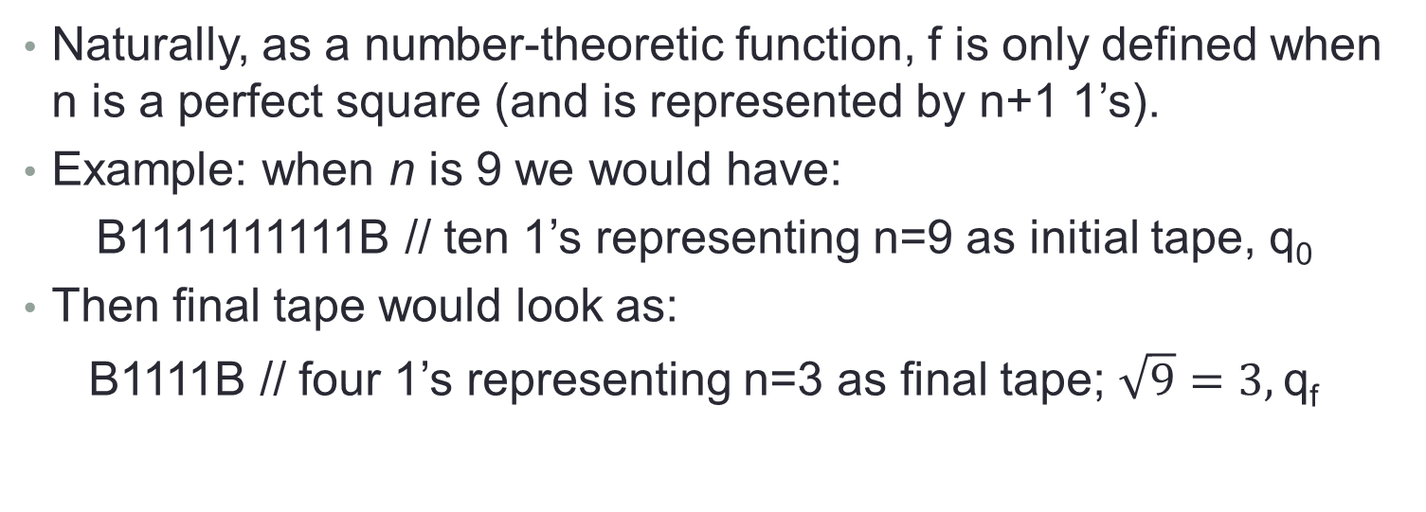
Example 1.5.2

Slide 6
Example 1.5.2 cont
What should our TM do when n is not a perfect square?
For example when n = 5
B111111B // initial tape six 1’s
q₀
neither
B111B // n = 2
q_{f}
nor
B1111B // n = 3
q_{f}
Are acceptable

Slide 7
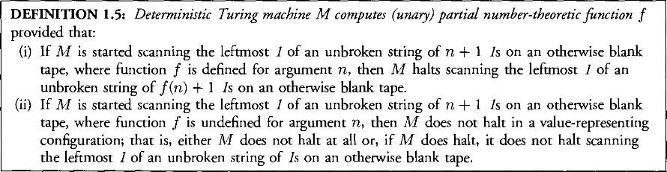
Example 1.5.2 cont
M should not halt in a value–representing configuration. Any of these would do
B11**1B OR B1X1ZB OR BB
q_{f} q_{f} q_{f}
Or M could not halt at all in these situations. More formally:

Slide 8
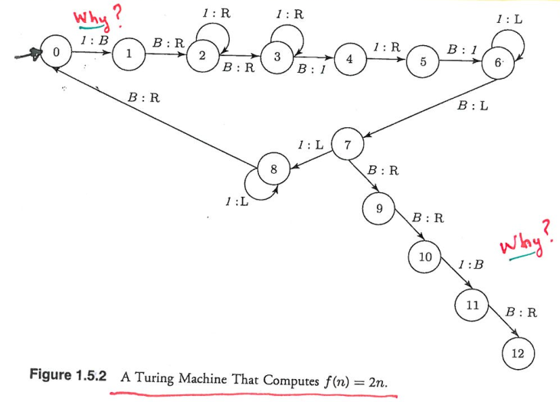
Example 1.5.3
A Turing machine, M, that computes
f(n) = 2n
Let us trace M when n = 2
B111B // initial tape, q₀
B11111B // final tape, q₁₂
BB11B1B //q₅
BB11B1 //q₄
BB11BB //q₃
BB11B //q₂
BB11B //q₂
BB11B //q₂
BB11B //q₁
BB11B11 //q₆
BB11B11 //q₆
BB11B11 //q₆
BB11B11 //q₇
BB11B11 //q₈
…

Slide 9
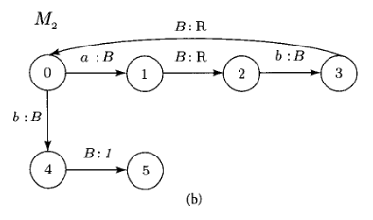

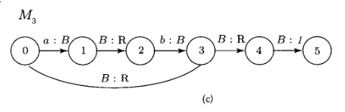
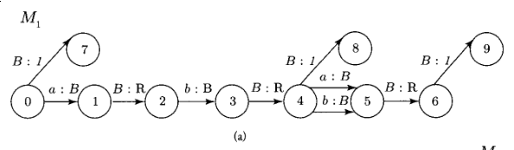
Homework (1.8.1 a-c)

Slide 10
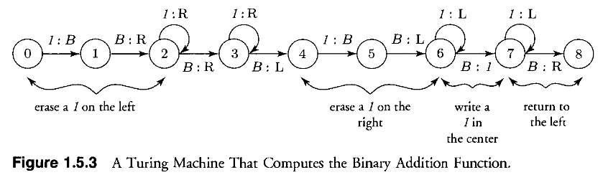
Example 1.5.4
A Turing machine, M, that computes the addition function
f(n, m) = n + m
Let us trace M when n = 2 and m = 3
B111B1111B // initial tape, q₀
BB11B111BB //q₆
BB11B1111B //q₂
BB11B1111B //q₁
BB111111BB //q₇
BB11B1111B //q₄
BB11B1111B //q₂
BB11B111BB //q₅
BB111111BB //q₇
BB11B1111B //q₃
BB111111BB //q_{f}
BB11B1111B //q₃
BB11B111BB //q₆
BB111111BB //q₈

Slide 11
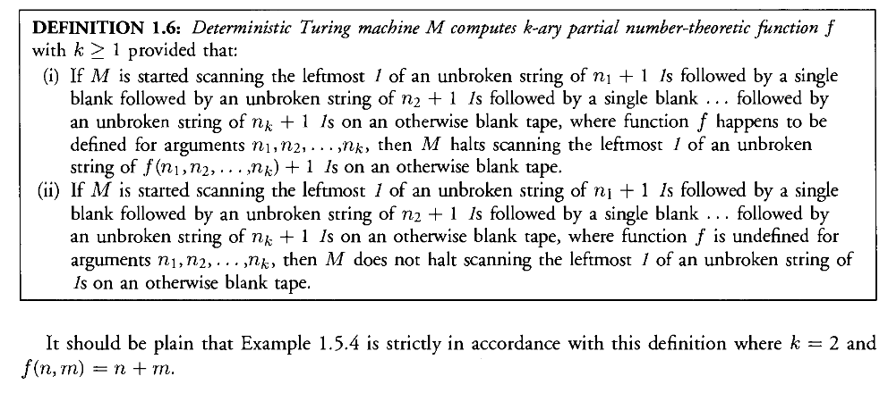
Final Remarks

Slide 12
Final Remarks cont.

Slide 13
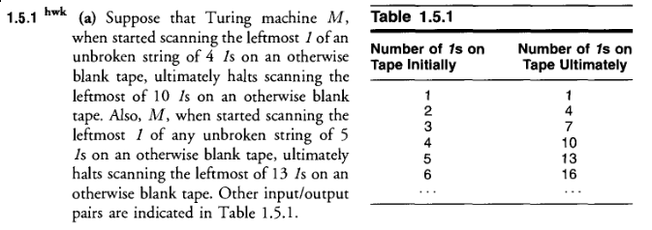

Homework (1.5.1a)

Slide 14
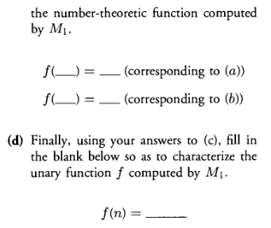
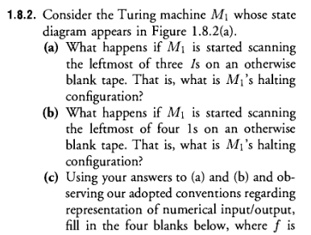
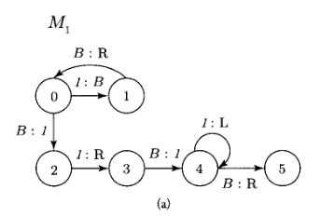

Homework (1.8.2)

Slide 15
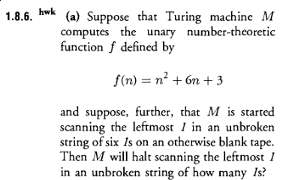


Homework (1.8.6a, 1.8.8, 1.8.9)

